Slide 1
Underwater Image Enhancement
Nandini Mundra
4NI16IS055

Slide 2
Underwater Imaging
Underwater environment offers various rare attractions such as marine animals and fishes, amazing landscapes etc..
Underwater images suffer from poor visibility due to the attenuation of the propagated light and due to the scattering effect.
Practically in common sea water images, the objects at a distance of more than 10 meters are almost unperceivable !!
So how will the pictures get clicked ?? There are various methods applied like gamma correction ,histogram equalization etc.. But they appear to be strongly limited for such a task.

Slide 3
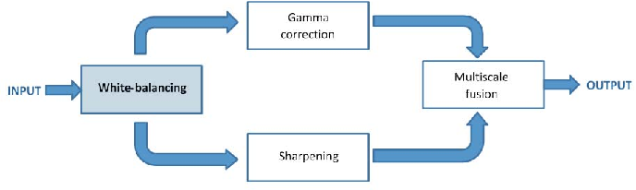
Enhancement Process
It is a 2 step process.
White Balancing
Multi-scale Fusion

Slide 4
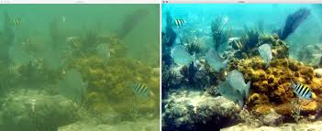
The figure below shows the result of the procedure applied on an image taken underwater which has the blurred effect and is affected due to scattering. The image next to it is the result of the enhancement process which is an improvised version of the old one!!

Slide 5
Background Knowledge
Light propagation in Underwater
Ideally the received light for the transmission is affected due to the target object and the lens of the camera.
But this is not the case underwater.
Factors:
Amount of light available underwater.
Density of the particles which the light has to go through.
Refractive index of water (25% enlarged image).

Slide 6



Total irradiance incident on a point of an image plane has three components in underwater medium.
Direct component:- It is the component reflected by the object onto the image plane.
Forward Scattering:- It results from the deviation of the light ray on its path to the lens of camera.
Back Scattering:- :- It is due to the artificial light which hits the water particles and gets reflected back to the camera
OVERALL :-

Slide 7
Underwater White Balance
Aims at compensating the color cast caused by the selective absorption of color with depth.
Removes the undesired color castings due to various illumination or medium attenuation properties.
Green- Bluish appearance need to be rectified.
Fact : Scattering attenuates more the longer wavelength than the shorter ones ; The color perception goes down as we go deeper in water.

Slide 8
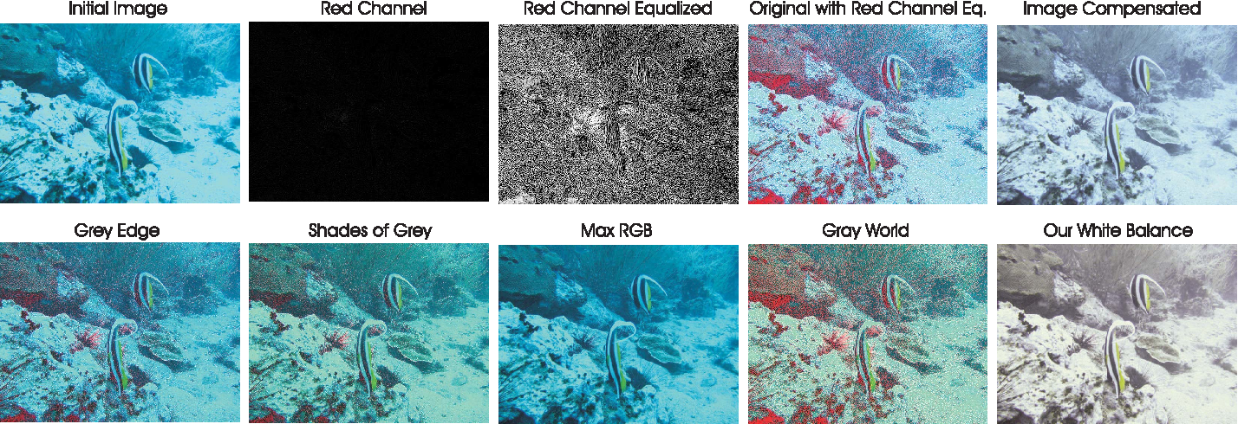
Figure shows the various methods of white balancing applied to a particular image like Gray World, Max RGB , Shades of Gray etc…
Gray world algorithm achieves good visual performance for reasonably distorted images.

Slide 9
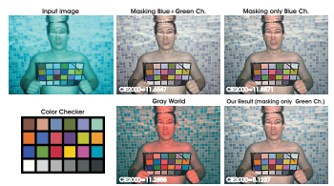
Drawback :
It suffers from serious red artifacts..!!
To compensate for the loss of red channel, the following observations are made:-
The green channel is relatively well preserved underwater, compared to the red and blue ones.
The green channel is the one that contains opponent color information compared to the red ones, So we add a fraction of green channel to the red one as shown:-

Slide 10

Mathematically the above observations can be expressed to propose the compensated red channel at every pixel location (x) as follows:
Similarly, the compensated blue channel can be computed as follows:
As a result , The reddish appearance of high intensity regions is well corrected since the red channel is better balanced..!!

Slide 11
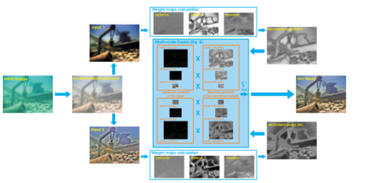
Multi- Scale Fusion
Image fusion plays a key role in various applications such as image composting, multi-spectral video enhancement, defogging etc.
A pair of inputs is introduced to respectively enhance the color contrast and the sharpness of the white-balanced image, and the weight maps are defined to preserve the qualities and reject the defaults of those inputs.

Slide 12
The underwater dehazing technique consists of three main steps:-
Inputs derivation for the white balanced underwater image
Weight maps definition
Multi-scale fusion of the inputs and weight map
Inputs of the fusion process:
For first input a set of gamma corrections is applied on the image, this in turn increases the difference between darker/lighter regions at a cost of a loss of details in the under/over exposed regions.
A second input is used which corresponds to the sharpened version of the white balanced image.

Slide 13

Unsharp masking principle is used in such a way that the blurred version of the image is blended with the image which need to be sharpened. The formula which describes the same is : q
This is known as NORMALIZED UNSHARP MASKING.
Weights of the Fusion Process
The pixels with high weight values are more represented in the final image. They are thus represented in the form of saliency metrics.

Slide 14

Laplacian contrast weight: In this global contrast is estimated as a result of the Laplacian filter applied to each input luminance channel. It is not much effective as it cannot differentiate between ramp and flat regions.
Saliency weight: It aims to emphasize the objects that lose their prominence in the underwater scene. It is derived from the concept of center-surround contrast. The drawback of using this is it tends to favor highlighted regions.
Saturation weight: It enables the fusion algorithm to adapt to the chromatic information. It can be calculated using the following formula.

Slide 15
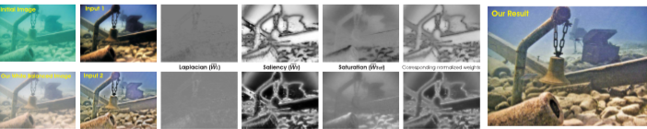
normalized weights of the corresponding weights.

Slide 16

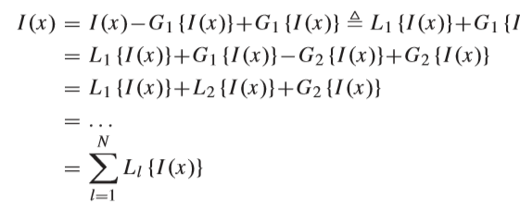
Naive Fusion Process
The reconstructed image is obtained by fusing the defined inputs with the weight measures at every pixel location (x). It is given as follows:
Produces undesired halos.
Multi Scale Fusion Process
based on Laplacian pyramid which decomposes the image into a sum of bandpass images.

Slide 17
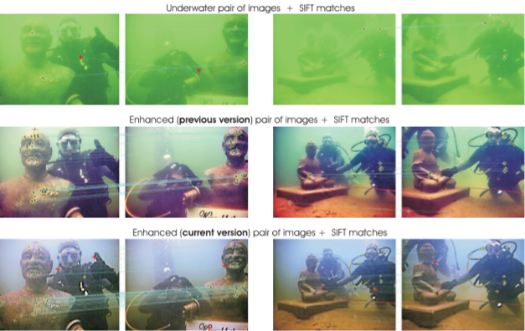
Results
This approach generally results in good perceptual quality, with significant enhancement of the global contrast, the color, and the image structure details.
The major limitations are of the fact that the color cannot always be fully restored and some haze is maintained.

Slide 18
Applications:
Segmentation aims to divide images into disjoint and homogenous regions with respect to some characteristics.
Local feature points matching is a fundamental task of many computer vision applications.

Slide 19
Thank You..!!

